Slide 1
Telco Customer Churn Analysis
Business Analytics Case Study
Prepared by: Michael Atumu
AnalystLab Africa Internship Program- week 1
Date:8 August 2026

Slide 2
Business Problem
Background
Customer churn is a significant challenge in the telecommunications industry. Losing customers reduces revenue and increases the cost of acquiring new customers.
Problem Statement
This analysis aims to identify the factors contributing to customer churn and provide actionable recommendations to improve customer retention.
Objectives
. Determine the customer churn rate.
. Identify the main drivers of churn.
. Recommend strategies to improve customer retention.

Slide 3
Dataset Overview
Dataset Information
Dataset: Telco Customer Churn
Source: Kaggle (IBM Sample Dataset)
Total Customers: 7,043
Total Features: 21
Target Variable: Churn
Tools Used
Microsoft Excel
Power BI

Slide 4
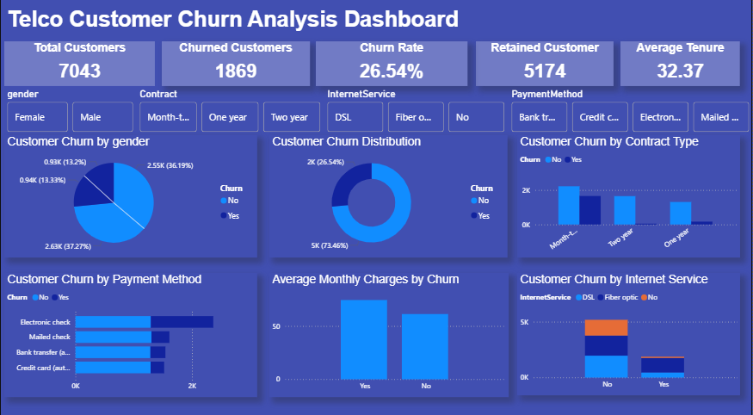

Slide 5
Key Findings
Overall customer churn rate is 26.54%.
Customers on month-to-month contracts are more likely to churn than those on one-year or two-year contracts.
Customers using electronic checks show higher churn compared to other payment methods.
Customers with Fiber Optic internet service experience higher churn than customers using DSL.
Customers who churn generally have higher average monthly charges.

Slide 6
Recommendations
Encourage customers to switch from month-to-month contracts to long-term contracts by offering discounts or loyalty incentives.
Investigate the reasons behind higher churn among Fiber Optic customers and improve service quality where needed.
Review pricing strategies for customers with higher monthly charges to improve perceived value.
Promote automatic payment methods through incentives to encourage convenient and consistent payments.
Develop targeted retention campaigns for customers identified as being at high risk of churning

Slide 7
Conclusion
The analysis identified several factors associated with customer churn, including contract type, internet service, payment method, and monthly charges. By acting on these insights, the company can strengthen customer retention, improve customer satisfaction, and reduce revenue loss.
Thank You

